Slide 1
MAT in Skid Row
Katy White, MD
Jason Nacorda, DO
October 25, 2018

Slide 2
Objectives
Understand steps needed to implement an MAT program in a community health setting in Skid Row
Discuss the complex journey of a person with opioid dependence
Understand 3 health disparities within this predominantly homeless community

Slide 3
Los Angeles Christian Health Centers
We are an FQHC that provides low-cost and no-cost health services throughout Skid Row, Boyle Heights and South Los Angeles.
Founded in 1995, operating in a small, 100 year old SRO hotel owned by the Los Angeles Mission. Federally Qualified Health Center in 2004, receiving government funding to serve the homeless population. We later received funding to serve the public housing populations as well, in Boyle Heights and South Los Angeles.
In 2017, our staff of approx. 150 cared for more than 10,500 people through over 62,000 medical, dental, social work, optometry, substance use and mental health visits. We had 582 substance abuse visits in 2017, vs 106 in 2016
Our network –which is focused on improving access for those who are homeless and living in public housing– includes 2 full-time clinics , 13 part-time satellite sites, and 3 functioning street teams.
Mission: To show God’s love by providing quality, comprehensive health care services to the homeless and underserved.

Slide 4
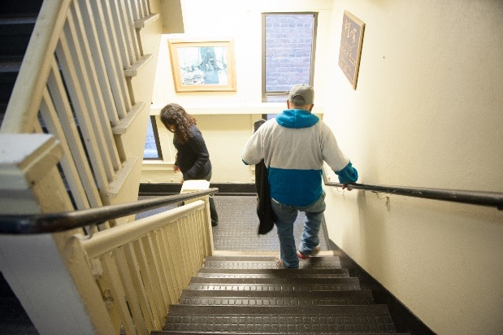
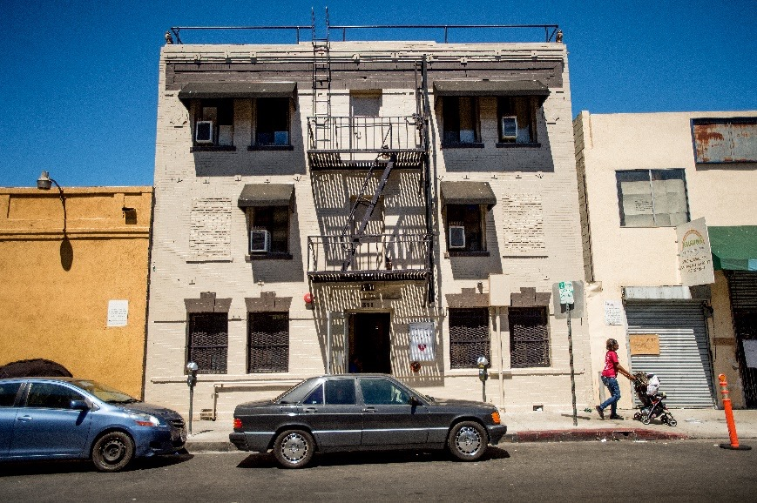
Joshua House in Skid Row

Slide 5
Need for MAT Services at LACHC
High amount of substance use in Skid Row, our target neighborhood
About 30% of the patients we serve struggle with substance use
Significant number of our patients use opioids, both heroin and opiate medications
Notes:
2015: 28% of our homeless patients had alcohol or other substance use disorders (not including tobacco abuse)
2017: 25% of our homeless patients had alcohol or other substance use disorders (not including tob abuse)

Slide 6
LACHC’s MAT Story
Received a HRSA Behavioral Health Integration grant in late 2014- Increased number of Mental Health staff
Increased our capacity to conduct SBIRTS (Screening, Brief Intervention, Referral for Treatment)– highlighted need for greater subst use services
Received a HRSA Substance Abuse Services Expansion grant 2016($325K), and LA Care Cross-Sector grant 2016 ($150K)
Allowed for partnership with Homeless Health Care LA (HHCLA)
Funded 2 part time HHCLA physicians to do MAT (8 hours/ week)
Also funded an outreach worker, substance abuse counselor, some medications/supplies/client incentives.
Funded outreach worker for SBIRTS in clinic, thru mid-2018

Slide 7
LACHC’s MAT Story (Continued)
Early 2016: 2 physicians at LACHC applied for DEA X-waiver
Summer 2016: Worked with part-time HHCLA physicians/staff to transition to using our EMR to expand detox services/induction to Buprenorphine for heroin addicts; detox/inductions at HHCLA center for harm reduction– initial plan was inductions at HHCLA, maintenance at LACHC
Fall 2016: Hired another physician to champion MAT program at LACHC, sent him to a CSAM training

Slide 8
LACHC’s MAT Story (Continued)
Fall-winter 2016-2017: Got more physicians and mid-level provider waivered
Since Fall 2016: program support through TAPC grant (3 in-person learning sessions, monthly coaching, monthly Project ECHO meetings) and CSAM webinars
Since Fall 2016: slow ramp up of maintenance and home induction patients

Slide 9
Skinner Box Rats - 1960’s
Rats would receive injection of heroin when pressing on lever
Some rats dosed themselves to the point of not eating/drinking and starved
Heroin thought to be a “demon drug”
Any exposure would lead to life-long addiction

Slide 10
Rat Park - 1970’s
Bruce Alexander
Professor of Psychology in Vancouver
Knew that rats were highly social, sexual and industrious creatures
Thought that keeping rats in Skinner boxes was unnaturally isolating
Would removing the rats from isolation yield different results?

Slide 11
Rat Park
Unlimited access to opioids
200x size of Skinner box
95 sq ft
Many rats from both sexes
Platforms for climbing
Tin cans for hiding
Wood chips for strewing around
Running wheels for exercise
Compared opioid use between “Rat park” rats and isolated rats

Slide 12
Skinner Boxes, Lab Rat Housing

Slide 13
Rat Park

Slide 14
Rat Park Results
Heroin use was up to 19x higher in isolated rats
Rat Park rats preferred social life and community engagement
Notes:
The extraordinary consumption of drugs in the Skinner boxed rats appeared to be an artifact of an impoverished environment (Alexander, 2010)

Slide 15
ACE Study - 1998
Examined association b/w childhood abuse and adult health risk behaviors
Psychologic, Physical, Sexual, Household dysfunction
ACE assoc. with earlier initiation and increased likelihood of substance use
> 4 ACE lead to 5-fold increased risk of substance use and 10-fold increased risk of injection use

Slide 16
Risk Environments
Promotes the understanding of harm as contingent on relationships to environment
Types of environments
Physical, Social, Economic, Policy
Redistributes responsibility for harm as something shared between individuals and socio-economic structures
Encourages consideration of both personal agency and responsibility of society

Slide 17
Complex Pathophysiology
Biologic, Psychologic, Social, Environmental, Economic, Political
Cumulative impact of multiple risk factors across time
Variation in symptoms and prognosis
Only about 10% of people who use substances will develop substance use disorder

Slide 18
LACHC MAT Care Team
Began prescribing in Fall 2016
Currently, 6 waivered LACHC providers, 3 of whom are actively prescribing
LACHC Pharmacy provides Buprenorphine for uninsured patients

Slide 19
Collaborative Partnership:
Homeless Health Care Los Angeles
Center for Harm Reduction
Needle Exchange
Group Counseling/Accupuncture/Computer Access
Two X-Waivered Physicians
Case managers
SUD Counselors

Slide 20
Harm Reduction Model
Compassionate pragmatism
Emphasizes individuals choice and goals they identify as meaningful
Tolerance of treatment goals other than abstinence
Expands services available to people who have not benefited from traditional, abstinence-based treatment

Slide 21
Opioid use/dependence
We do not use pejorative terms
Abusers/Addicts
Dirty/Clean
Using only objective terms
Opioid use/dependence
Positive/Negative (i.e. UDS findings)

Slide 22
Homeless Healthcare LA
Offer MAT Inductions to clients that already utilize the Needle Exchange, etc.
Severe Opioid Dependence
Use Buprenorphine alone
Direct observation dosing, in-clinic induction
Meet with SUD counselors
2-day follow up
14-21 day “Detox” Program

Slide 23
Detox to Maintenance
Pts who complete “Detox” Program at HHCLA
Transition care to Maintenance at LACHC
“Warm-handoff” from HHCLA
Case managers
EMR progress notes

Slide 24
Patient Stories - Mr. and Ms. S
Mr. and Ms. S, both with opiate pill and heroin use
Uninsured
Both were struggling to hold jobs
Financial issues/Housing issues
Strained relationship
Medical issues

Slide 25
Patient Stories - Mr. S
Initially, did not want to be on Buprenorphine long-term
Wanted to be on Buprenorphine for “detox”
Induced at HHCLA in 9/2016
Transitioned to LACHC maintenance
UDS was + MOP, + BZO until 5/2017
Last + MOP was 8/2017
After 11 months on Buprenorphine

Slide 26
Patient Stories - Mr. S (cont)
Current goal - To stay on Buprenorphine long-term
Doing very well at work, recent promotion
Healthy relationship
Spending more time with family and friends
Has referred friends to LACHC MAT program
Returns to clinic monthly

Slide 27
Patient Stories - Ms. S
Opiate pills to Heroin use
Initial goals of Buprenorphine “Detox”
Wanted to be off all opioids
Induced at HHCLA in 9/2016
Transitioned to LACHC maintenance
UDS was + MOP until 5/2017
After 4-week Rx of Buprenorphine
Voiced she prefers 2-week Rx’s

Slide 28
Patient Stories - Ms. S (cont.)
Began attending Cosmetology school in 5/2017
Graduated and began work in Make-up Department
Happy in her relationship, engaged
Currently with stable job
Stable financially
Returns to clinic monthly

Slide 29
Patient Stories- Health Disparities
Homelessness/Housing issues
Low-income
Uninsured
Poor social support
Transportation difficulty
History of incarceration
History of physical/sexual abuse

Slide 30
Pathways to LACHC MAT
HHCLA “Detox” Program Completion
HHCLA Clients who prefer Maintenance
Walk-ins
Online Registries
“In-House” Referrals
Existing LACHC Patients
MAT patient family/friends

Slide 31
LACHC MAT
Do not perform In-Clinic Inductions
Utilize NYU School of Medicine- Packet for “Home” Inductions
Induction Guidance
Timing of Dosing
Dosage amount
Follow up

Slide 33
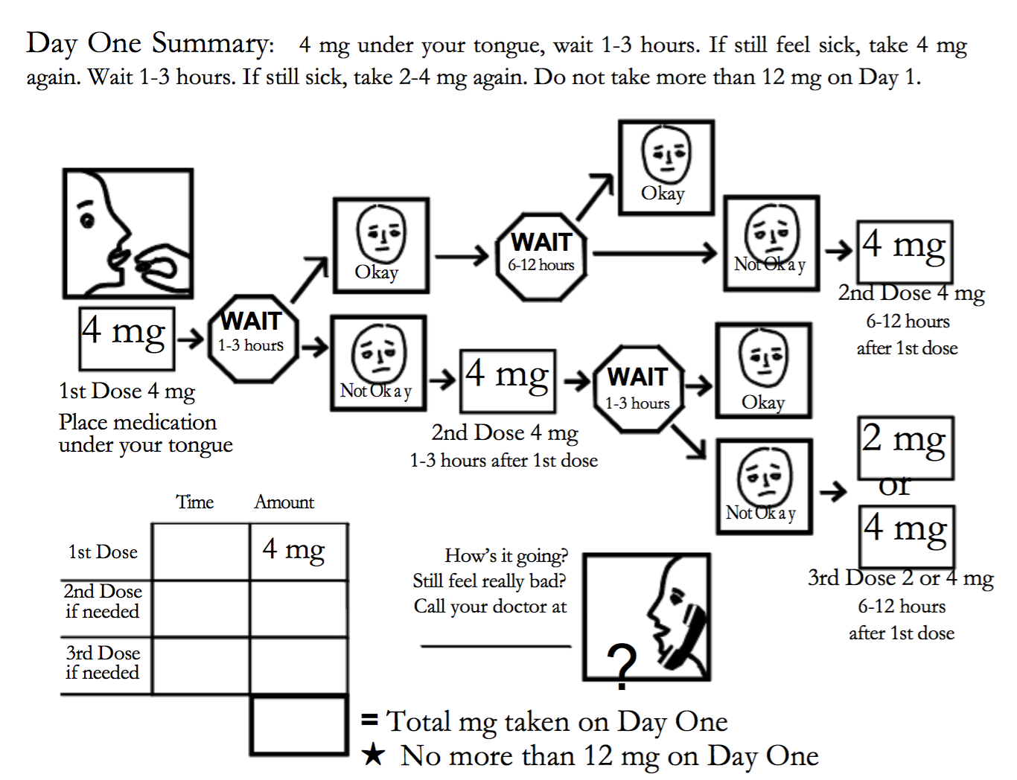

Slide 34
Initial MAT Visit
Urine Drug Screen
Buprenorphine vs other opioids
Psychosocial Assessment
Discuss Patient Goals (Short vs. Long term)
Check CURES
Liver Function Tests
Prescribe Naloxone Kit
Buprenorphine/Naloxone
2-7 day follow up

Slide 35
Follow-Up MAT Visit
Urine Drug Screen
Challenges/successes
Patient goals
Cravings/Dosage
Offer in-house services
2-7 day follow up

Slide 36
Patient Stories - Ms. K
IV Heroin Use for over 20 years
Methadone program
Also, with benzodiazepine use
History of incarceration
History of physical/sexual abuse
Many difficult social factors
Work, housing, financial, transportation
Induced at LACHC in 6/18
Needing multiple inductions
Following up weekly

Slide 37
In-House Patient Services
Case management
Housing, Employment, Transportation
Mental Health
Medical/Dental/Optometry
Enrollment & Retention
SUD counselor available once/week

Slide 38
Multiple MAT Sites
Joshua House
Center for Harm Reduction with HHCLA
Midnight Mission, other satellite sites in Skid Row
Pico Aliso Community Clinic in East LA

Slide 39
Patient Stories - Mr. R
Chronic pain
Noted as “difficult patient”
Previous hx of heroin use
Fired by pain specialist
Endorsed feelings of anxiety, restlessness between dosages of opiates
Family arguments, stress
Buying methadone off the street

Slide 40
Patient Stories - Mr. R (cont)
Induced at LACHC in 4/2018
+ MTD, + MOP before induction
- MTD, - MOP after induction
Reports improved anxiety, restlessness
Improved relationships with wife and children
Referred family members to our MAT program

Slide 41
MAT Coaching
Program Support thru TAPC Grant
Monthly Coaching Conference Calls
Brian Hurley, MD, Addiction Psychiatry
Difficult Cases
Inductions
Dosages
Diversion
Benzodiazepines, Methadone, Opiates

Slide 42
MAT Team Unity
MAT providers work within similar guidelines
Use of Treatment Templates to adhere to standard
Monthly meetings with HHCLA to discuss program challenges

Slide 43
Current Status of MAT
2017
100 unique patients
2018
January - September
105 unique patients
Currently, 35 MAT patients monthly
Notes:
As of 8/3/18: The running total of unique patients receiving MAT treatment at all LACHC sites in 2018 is 89: 35 induced or re-induced in 2018 by HHCLA/ CHR, 37 new patients to other LACHC sites through inductions at LACHC or referrals from outside clinics for maintenance therapy, and 17 carry over patients on maintenance from 2017.
From the inception of the grant period in Aug 2016 thru dec 2017, 88 patients received Medication Assisted Treatment through HHCLA and 12 directly through LACHC, totaling 100 unique patients treated with MAT through December 2017.

Slide 44
Barriers-
Prescriber Perceptions
“Difficult” patients
Time consuming visits
High risk of diversion of Buprenorphine
Many missed appointments
Disturbing to other patients
Manipulative
Differing goals of treatment

Slide 45
Barriers-
Patient challenges
No/Inactive insurance
No ID/phone
Difficulty making appointments
Can’t leave partner/tent/belongings
Don’t trust doctors/medical society
Other substance use
Psychiatric disease

Slide 46
Patient Stories - Mr. H
Undocumented, uninsured
IV Heroin use for 20 years
History of incarceration
Previously homeless
Married but strained relationship
Previously attempted Methadone program
Induced at HHCLA in 3/2017
Needed multiple inductions
Transitioned to LACHC Maintenance in 6/2017

Slide 47
Patient Stories - Mr. H (cont)
Artist by trade
Financially support his family
Reports relationship with wife is the best it has ever been in 20 years
Expecting their first born child this year
Enjoys working consistent job
Returns to clinic monthly

Slide 48
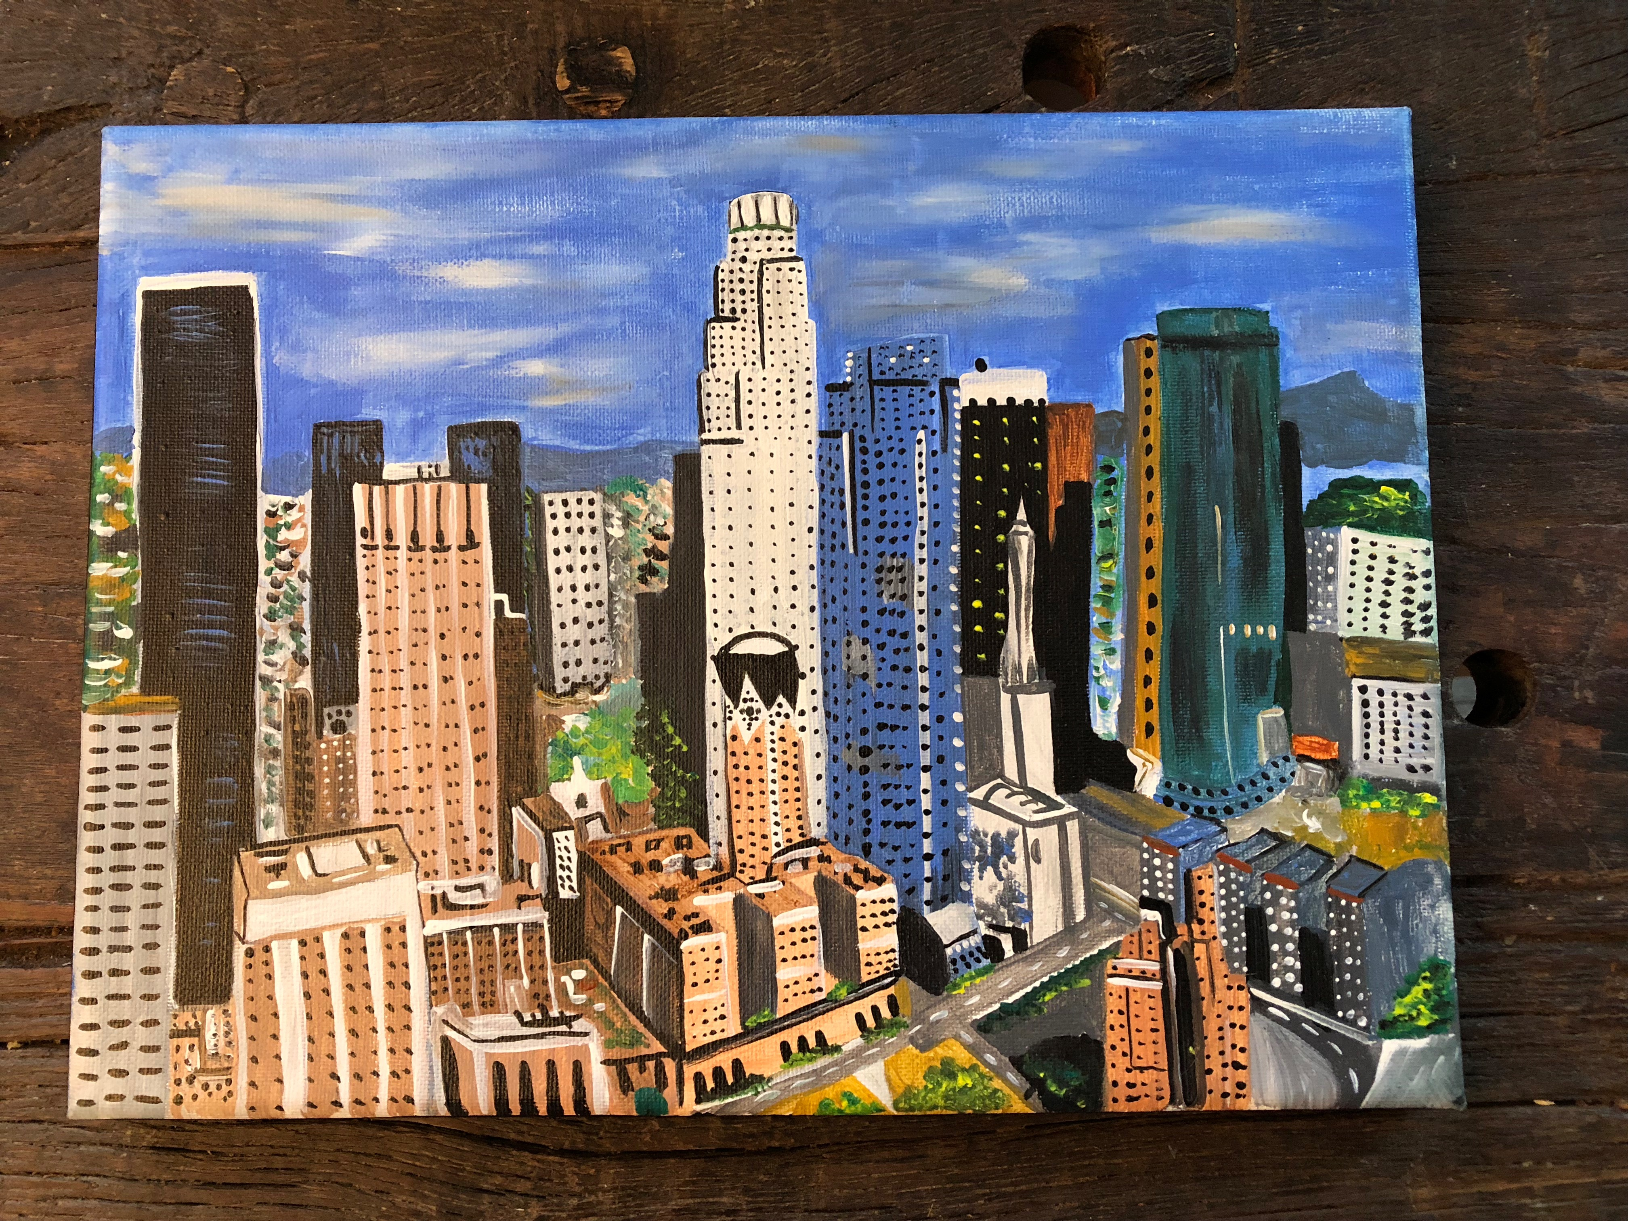

Slide 49
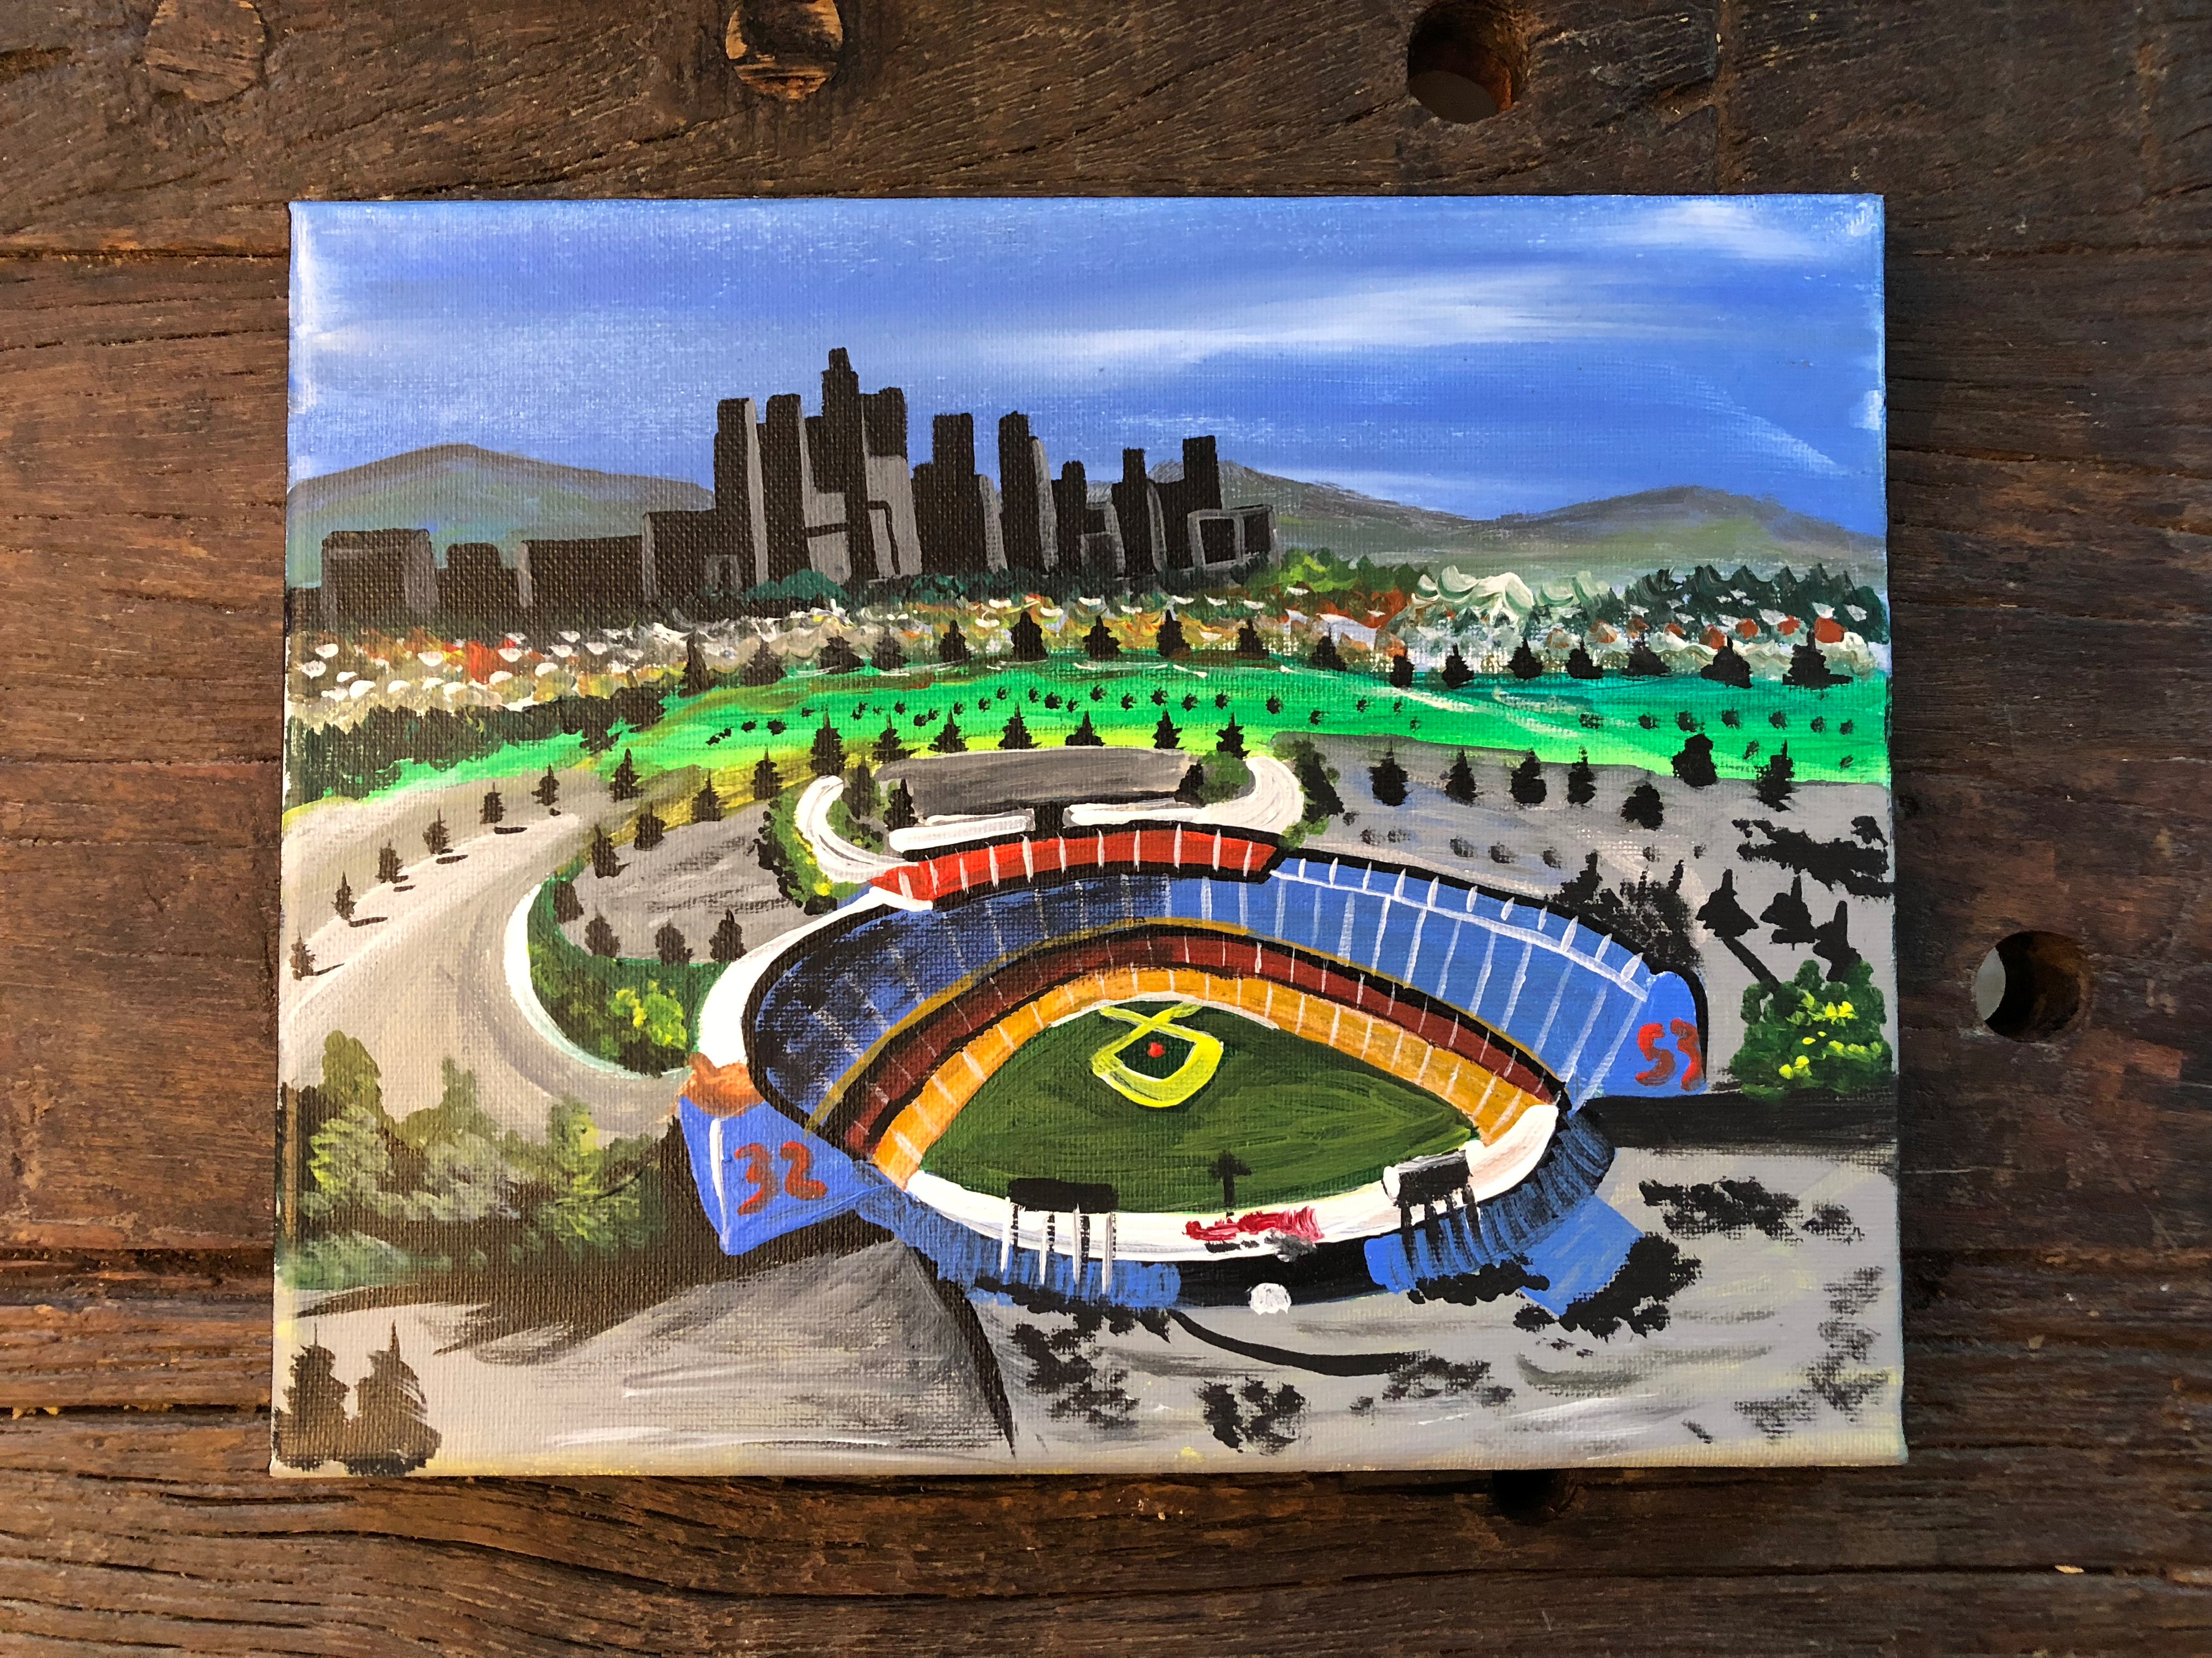

Slide 50
Program Growth
To further integrate mental health and case management services
Increase cultural competency, to be more sensitive to diversity and individuality of our community
To continue to partner with patients/community to improve program treatment goals

Slide 51
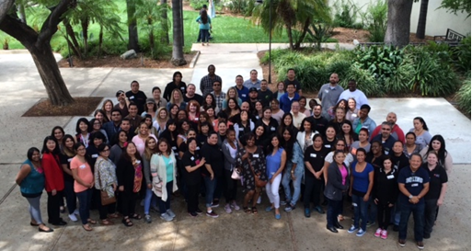
Healing
“The opposite of addiction is not sobriety. The opposite of addiction is connection”
- Johann Hari
Notes:
Celebrate Small Incremental Victories
Low Expectations, HIGH HOPES

Slide 52
Questions?
Jason Nacorda; jnacorda@lachc.com- MAT Champion
Katy White; kwhite@lachc.com- Chief Medical Officer

Slide 53
Resources
Alexander, Bruce. The Globalization of Addiction: A study in poverty of the spirit. (Oxford Univ. Press, 2010)
P Denning, J Little. Practicing Harm Reduction Psychotherapy, Second Edition: An Alternative Approach to Addictions.The Guilford Press; 2nd edition (October 24, 2011)
GA Marlatt, Arthur W. Blume & George A. Parks (2001) Integrating Harm Reduction Therapy and Traditional Substance Abuse Treatment, Journal of Psychoactive Drugs, 33:1, 13-21
GA Marlatt, ME Larimer, K Witkiewitz. Harm Reduction, Second Edition. Pragmatic strategies for Managing High-risk behaviors. The Guilford Press; Second edition (December 7, 2011)
Rhodes, Tim. “Risk environments and drug harms: A social science for harm reduction approach.” The International Journal of Drug Policy.May 2009. Volume 20, Issue 3, Pages 193–201.

